Slide 1


Shortest Paths: Single-Source and All-Pairs
20
PART V · GRAPH ALGORITHMS
CHAPTER 20 · WEEK 14
Design, Proof and Measurement
LECTURER
Dr. Mustafa Hameed
THE ISLAMIA UNIVERSITY OF BAHAWALPUR
Bahawalpur, Pakistan
Department of Information Technology · BSIT · Fall 2026
Notes:
Chapter 20: Shortest Paths: Single-Source and All-Pairs. Part 5 — Graph Algorithms. Week 14: Shortest paths. Handout pages 162–172.

Slide 2

Where this chapter sits
THE COURSE
PART I
PART II
PART III
PART IV
PART V
PART VI
1
2
3
4
5
6
7
8
9
10
11
12
13
14
15
16
17
18
19
20
21
22
23
Shortest Paths: Single-Source and All-Pairs
BUILDS ON
USED LATER IN
Ch 14 Greedy Algorithms
Ch 23 The Semester Project
Ch 15 Dynamic Programming I: The Elements
Ch 18 Graphs: Representation, Traversal and Sparsity
Analysis of Algorithms · Chapter 20 · Shortest Paths: Single-Source and All-Pairs
Handout p. 162 2
Notes:
Place the chapter. Before you start: Chapter 18 for representation and BFS — Dijkstra is BFS with a priority queue. Chapter 14 for the exchange argument. Chapter 15 for Floyd–Warshall, which is a dynamic program.

Slide 3

What you will be able to do
LEARNING OUTCOMES
By the end of this chapter you will be able to:
1
Solve single-source shortest-path problems with Dijkstra’s and Bellman–Ford’s algorithms (CLO-7).
2
Prove Dijkstra’s algorithm correct and identify the step that requires non-negative weights.
3
Construct a graph on which Dijkstra’s algorithm returns a wrong answer, and explain why.
4
Apply Floyd–Warshall to the all-pairs problem and justify the loop order.
5
Choose among the three algorithms given density, weights and the number of sources required.
Analysis of Algorithms · Chapter 20 · Shortest Paths: Single-Source and All-Pairs
Handout p. 162 3
Notes:
Read these out: they are the chapter's contract with the room. Each click adds one.

Slide 4

Vocabulary for this chapter
KEY TERMS
shortest path
relaxation
Dijkstra
Bellman–Ford
Floyd–Warshall
negative edge
negative cycle
single-source
all-pairs
optimal substructure
early termination
Each term is defined where it first matters — not here.
Analysis of Algorithms · Chapter 20 · Shortest Paths: Single-Source and All-Pairs
Handout p. 162 4
Notes:
Do not define these now; they arrive one at a time. This slide is for the students' notes. Terms: shortest path; relaxation; Dijkstra; Bellman–Ford; Floyd–Warshall; negative edge; negative cycle; single-source; all-pairs; optimal substructure; early termination.

Slide 5

In this chapter
IN THIS CHAPTER
20.1
Relaxation, the Common Operation
p. 162 ›
20.2
Dijkstra
p. 163 ›
20.3
Bellman–Ford
p. 164 ›
20.4
One Negative Edge
p. 166 ›
20.5
All Pairs
p. 166 ›
Analysis of Algorithms · Chapter 20 · Shortest Paths: Single-Source and All-Pairs
Handout pp. 162–172 5
Notes:
The route through the chapter. Each row is a link: click it to jump to that section in the slide show.

Slide 6
Relaxation, the Common Operation
SECTION 1 OF 5
20.1
20.1 Relaxation, the Common Operation
20.2 Dijkstra
20.3 Bellman–Ford
20.4 One Negative Edge
20.5 All Pairs
Analysis of Algorithms · Chapter 20
Handout §20.1 6
Notes:
Pause. Name the question this section answers.

Slide 7

Relaxation
DEFINITION
Each algorithm here maintains an estimate d[v] ≥ δ(s,v), the true shortest distance. Relaxing an edge (u,v) asks whether going via u improves it:
All three algorithms do only this. They differ entirely in the order in which edges are relaxed, and that order is what buys or costs the running time.
Analysis of Algorithms · Chapter 20 · Shortest Paths: Single-Source and All-Pairs
§20.1 · Handout p. 162 7
Notes:
Read the box aloud, then ask for an example from the room before moving on.

Slide 8

Optimal substructure, and where it comes from
CONCEPT
Any subpath of a shortest path is itself a shortest path: if p is a shortest path from s to v passing through u, the portion from s to u must be shortest, or substituting a shorter one would improve p.
That is a cut-and-paste argument, and it is the optimal substructure of Chapter 15. It is why shortest paths yield to both greedy (Dijkstra) and dynamic programming (Floyd–Warshall) — and why longest simple paths do not, since a subpath of a longest simple path need not be a longest simple path.
Analysis of Algorithms · Chapter 20 · Shortest Paths: Single-Source and All-Pairs
§20.1 · Handout p. 162 8
Notes:
Read the box aloud, then ask for an example from the room before moving on.

Slide 9
Dijkstra
SECTION 2 OF 5
20.2
20.1 Relaxation, the Common Operation
20.2 Dijkstra
20.3 Bellman–Ford
20.4 One Negative Edge
20.5 All Pairs
Analysis of Algorithms · Chapter 20
Handout §20.2 9
Notes:
Pause. Name the question this section answers.

Slide 10
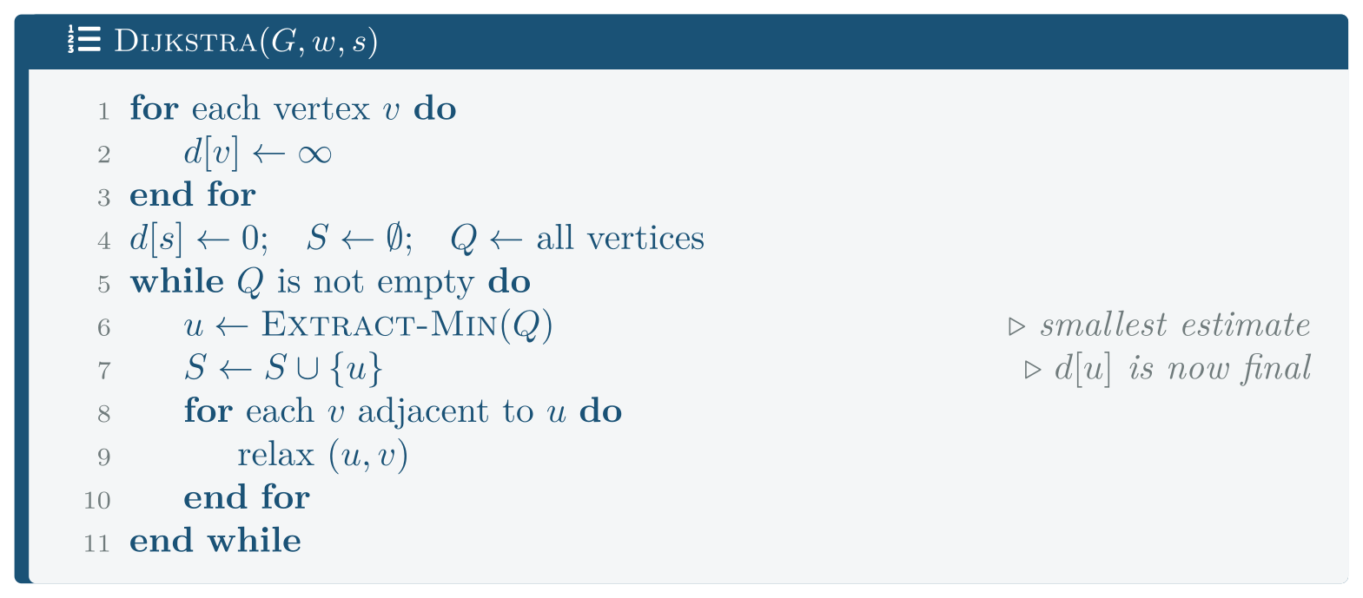
Dijkstra
FIGURE 20.1
Dijkstra. Line 7 is the greedy commitment: once a vertex is extracted its distance is declared final and never reconsidered. Theorem 20.1 is what justifies that, and Section 20.4 is what happens when its hypothesis fails.
Analysis of Algorithms · Chapter 20 · Shortest Paths: Single-Source and All-Pairs
§20.2 · Handout p. 163 10
Notes:
Figure 20.1 (handout p. 163): Dijkstra. Line 7 is the greedy commitment: once a vertex is extracted its distance is declared final and never reconsidered. Theorem 20.1 is what justifies that, and Section 20.4 is what happens when its hypothesis fails.

Slide 11

Dijkstra is correct
THEOREM 20.1
If every edge weight is non-negative, then when Dijkstra adds u to S, d[u] = δ(s,u).
Analysis of Algorithms · Chapter 20 · Shortest Paths: Single-Source and All-Pairs
§20.2 · Handout p. 163 11
Notes:
Proof. Suppose not, and let u be the first vertex added to S with d[u] ≠ δ(s,u). Then u ≠ s, and δ(s,u) < ∞ (otherwise d[u] = ∞ = δ(s,u)). Consider a shortest path p from s to u. Since s ∈ S and u ∉ S at the moment before u is added, p must leave S at some point: let y be the first vertex on p not in S, and x ∈ S its predecessor. Because x was added to S earlier and u is the first mistake, d[x] = δ(s,x). The edge (x,y) was relaxed when x was added, so d[y] = δ(s,x) + w(x,y) = δ(s,y), the second equality because the prefix of a shortest path is a shortest path. Now y appears on a shortest path to u and all remaining edge weights are non-negative, so δ(s,y) ≤ δ(s,u). But u was chosen by Extract-Min over y, so d[u] ≤ d[y]. Chain them: d[u] ≤ d[y] = δ(s,y) ≤ δ(s,u) ≤ d[u], the last because d never underestimates. So all are equal and d[u] = δ(s,u) — contradicting the choice of u.

Slide 12

Exactly one step used non-negativity
WATCH OUT
The inequality δ(s,y) ≤ δ(s,u). It says that extending a path can never make it cheaper.
With a negative edge that is false: the rest of the path from y to u might have negative total weight, so δ(s,u) could be less than δ(s,y), and a vertex finalised early may later turn out to have been reachable more cheaply. The greedy commitment on line 7 is then unjustified.
Section 20.4 builds the graph where this happens.
Analysis of Algorithms · Chapter 20 · Shortest Paths: Single-Source and All-Pairs
§20.2 · Handout p. 163 12
Notes:
Read the box aloud, then ask for an example from the room before moving on.

Slide 13

Which Priority Queue, Measured
WORKED EXAMPLE
|V| = 4,000, density varying. code/ch20_sp.cpp compares a binary heap with an unsorted array (extract-min by linear scan):
avg degree | |E| | heap (ms) | array (ms) | winner
2 | 7,998 | 0.36 | 46.77 | heap
32 | 127,970 | 1.97 | 53.39 | heap
512 | 2,047,499 | 6.40 | 62.63 | heap
2000 | 7,998,035 | 15.32 | 63.47 | heap
The array column is flat — 47 to 63 ms while |E| grows 1000-fold — which is O(|V|²) behaving exactly as advertised, just as the adjacency matrix did in Chapter 18.
Analysis of Algorithms · Chapter 20 · Shortest Paths: Single-Source and All-Pairs
§20.2 · Handout p. 163 13
Notes:
Each click adds one step of the working. Ask for the next number before you reveal it.

Slide 14
Which Priority Queue, Measured (continued)
WORKED EXAMPLE
But the textbook crossover does not appear. The standard claim is that the O(|V|²) array version wins on dense graphs, since |E| ≈ |V|² makes the heap’s lg|V| factor pure overhead. Here the heap won at every density, including |E| = 8 × 10⁶ — half of complete.
The honest reading is that at |V| = 4,000 the array’s |V|² = 1.6×10⁷ branch-laden scans cost more than |E| lg|V| = 10⁸ well-predicted heap operations on this processor. Chapter 18 found the same thing and fixed it by bit-packing; there is no equivalent trick here, because the array version must examine real distances rather than single bits. The crossover is real asymptotically and did not arrive at any size tested.
Analysis of Algorithms · Chapter 20 · Shortest Paths: Single-Source and All-Pairs
§20.2 · Handout p. 163 14
Notes:
Each click adds one step of the working. Ask for the next number before you reveal it.

Slide 15
Bellman–Ford
SECTION 3 OF 5
20.3
20.1 Relaxation, the Common Operation
20.2 Dijkstra
20.3 Bellman–Ford
20.4 One Negative Edge
20.5 All Pairs
Analysis of Algorithms · Chapter 20
Handout §20.3 15
Notes:
Pause. Name the question this section answers.

Slide 16
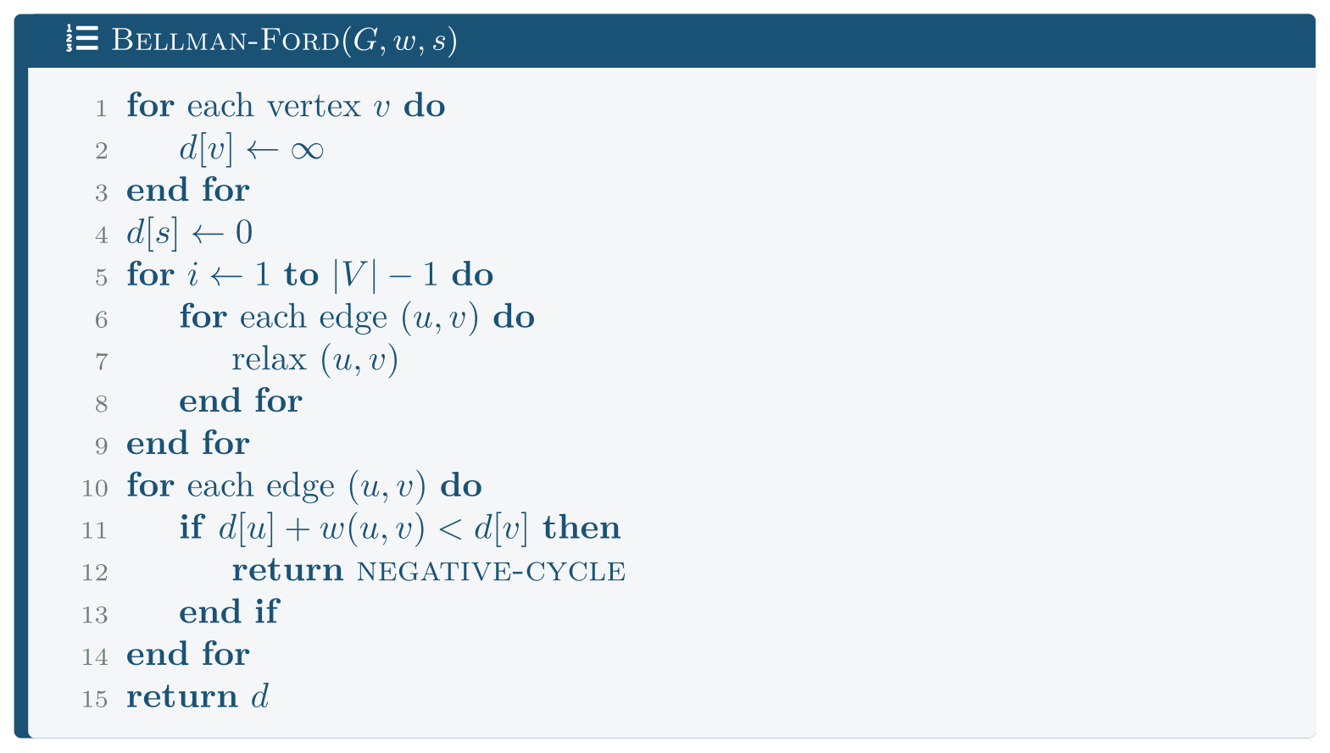
Bellman-Ford
FIGURE 20.2
No priority queue and no assumption about signs: O(|V||E|). The final pass is not decoration — it is the only way to detect a negative cycle, which Dijkstra cannot do at all.
Analysis of Algorithms · Chapter 20 · Shortest Paths: Single-Source and All-Pairs
§20.3 · Handout p. 164 16
Notes:
Figure 20.2 (handout p. 164): Bellman-Ford. No priority queue and no assumption about signs: O(|V||E|). The final pass is not decoration — it is the only way to detect a negative cycle, which Dijkstra cannot do at all.

Slide 17
Bellman–Ford
THEOREM 20.2
If G has no negative-weight cycle reachable from s, then after |V|−1 passes d[v] = δ(s,v) for every v.
Analysis of Algorithms · Chapter 20 · Shortest Paths: Single-Source and All-Pairs
§20.3 · Handout p. 164 17
Notes:
Proof. A shortest path has at most |V|−1 edges: if it had more it would repeat a vertex, and the cycle so formed has non-negative weight (by hypothesis) and can be removed without lengthening the path. Now argue by induction that after i passes, d[v] = δ(s,v) for every v whose shortest path uses at most i edges. After 0 passes this holds for v = s. For the step: let v have a shortest path s u → v using i+1 edges; its prefix to u uses i edges and is shortest, so by hypothesis d[u] = δ(s,u) after i passes. Pass i+1 relaxes (u,v) and sets d[v] ≤ δ(s,u)+w(u,v) = δ(s,v); since d never underestimates, equality holds. After |V|−1 passes every shortest path is covered. If a further relaxation still improves some d[v], then some path uses |V| or more edges and is still improving, which requires a negative cycle.

Slide 18
Bellman–Ford Is Faster Than Its Bound Suggests
WORKED EXAMPLE
On random graphs with non-negative weights, average degree 8:
|V| | Dijkstra (ms) | Bellman–Ford (ms) | ratio | agree?
2,000 | 0.40 | 0.3 | 0.8 | yes
8,000 | 1.89 | 1.7 | 0.9 | yes
32,000 | 11.21 | 11.0 | 1.0 | yes
Bellman–Ford matched Dijkstra, despite a bound of O(|V||E|) against O(|E| lg|V|) — a predicted factor of |V|/lg|V| ≈ 2,000.
The reason is the early exit: the implementation stops when a pass changes nothing, and on a random graph the distances settle after a handful of passes rather than |V|−1. The O(|V||E|) bound is a worst case that random graphs do not come close to.
Analysis of Algorithms · Chapter 20 · Shortest Paths: Single-Source and All-Pairs
§20.3 · Handout p. 164 18
Notes:
Each click adds one step of the working. Ask for the next number before you reveal it.

Slide 19
Bellman–Ford Is Faster Than Its Bound Suggests (continued)
WORKED EXAMPLE
So does the bound ever materialise? It needs a graph that forces every pass — a long path whose edges are relaxed in the wrong order, so information advances one vertex per pass:
|V| | Dijkstra (ms) | Bellman–Ford (ms) | ratio | passes used
1,000 | 0.03 | 1.4 | 44.9 | 999
2,000 | 0.03 | 5.5 | 190.8 | 1,999
4,000 | 0.06 | 21.8 | 386.9 | 3,999
8,000 | 0.11 | 87.2 | 789.5 | 7,999
There it is: 789× slower, and the ratio doubling with |V|. The graph is not adversarial in its weights — every edge costs 1. Only the order the adjacency lists are visited in is unfavourable.
Analysis of Algorithms · Chapter 20 · Shortest Paths: Single-Source and All-Pairs
§20.3 · Handout p. 164 19
Notes:
Each click adds one step of the working. Ask for the next number before you reveal it.

Slide 20
Bellman–Ford Is Faster Than Its Bound Suggests (continued)
WORKED EXAMPLE
The lesson is about benchmarking, not about Bellman–Ford. Measuring only on random inputs would have shown the two algorithms as equals. It is the third time this book has made that point — Chapter 9’s sorted input, Chapter 12’s sorted insertions, Chapter 13’s structured keys — and it will not be the last.
Analysis of Algorithms · Chapter 20 · Shortest Paths: Single-Source and All-Pairs
§20.3 · Handout p. 164 20
Notes:
Each click adds one step of the working. Ask for the next number before you reveal it.

Slide 21
Dijkstra, Measurably Wrong
WORKED EXAMPLE
Four vertices. 0 → 1 costs 3, 0 → 2 costs 4, 2 → 1 costs −2, and 1 → 3 costs 1. The true distances are d(1) = 2 (via vertex 2) and therefore d(3) = 3.
vertex | Dijkstra (array) | Dijkstra (heap) | Bellman–Ford | correct
0 | 0 | 0 | 0 | 0
1 | 2 | 2 | 2 | 2
2 | 4 | 4 | 4 | 4
3 | 4 | 3 | 3 | 3 | wrong
Trace it. The array version pops vertex 1 at distance 3 and finalises it, relaxing 1 → 3 to give d(3) = 4. It then pops vertex 2 and lowers d(1) to 2 — but vertex 1 is already done, so its outgoing edge is never re-examined and d(3) stays at 4.
Analysis of Algorithms · Chapter 20 · Shortest Paths: Single-Source and All-Pairs
§20.4 · Handout p. 166 21
Notes:
Each click adds one step of the working. Ask for the next number before you reveal it.

Slide 22
Dijkstra, Measurably Wrong (continued)
WORKED EXAMPLE
Notice that d(1) itself ends up correct. The error is only visible at vertex 3, because the wrong value had already propagated. The three-vertex example people usually reach for does not fail, for exactly this reason: the wrong value is overwritten before anything depends on it. A counter-example has to let the mistake escape.
And the heap version got it right — which is an accident worth understanding. The lazy heap implementation never marks anything final; it re-pushes whenever an estimate improves. On this graph that lets it recover. It is behaving like Bellman–Ford, not like Dijkstra, and on adversarial graphs with negative edges it can take exponential time. “Dijkstra is wrong on negative edges” is a statement about the algorithm; whether your program visibly fails depends on which implementation you wrote.
Analysis of Algorithms · Chapter 20 · Shortest Paths: Single-Source and All-Pairs
§20.4 · Handout p. 166 22
Notes:
Each click adds one step of the working. Ask for the next number before you reveal it.

Slide 23
Dijkstra, Measurably Wrong (continued)
WORKED EXAMPLE
Negative cycles. On this graph Bellman–Ford reported none, correctly. Adding a cycle 0 → 1 → 2 → 0 of total weight −1, it reported one — also correctly. Dijkstra cannot detect a negative cycle at all, and with one present “shortest path” is undefined, since going round again is always cheaper.
Analysis of Algorithms · Chapter 20 · Shortest Paths: Single-Source and All-Pairs
§20.4 · Handout p. 166 23
Notes:
Each click adds one step of the working. Ask for the next number before you reveal it.

Slide 24
All Pairs
SECTION 5 OF 5
20.5
20.1 Relaxation, the Common Operation
20.2 Dijkstra
20.3 Bellman–Ford
20.4 One Negative Edge
20.5 All Pairs
Analysis of Algorithms · Chapter 20
Handout §20.5 24
Notes:
Pause. Name the question this section answers.

Slide 25
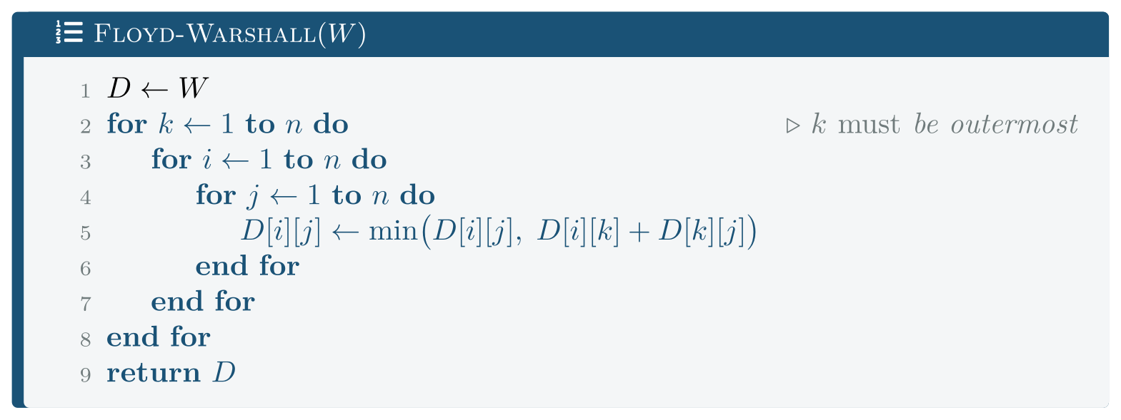
Floyd-Warshall
FIGURE 20.3
Five lines, Θ(n3) regardless of density, and the smallest constant of any algorithm in this chapter — three nested loops over contiguous memory.
Analysis of Algorithms · Chapter 20 · Shortest Paths: Single-Source and All-Pairs
§20.5 · Handout p. 166 25
Notes:
Figure 20.3 (handout p. 166): Floyd-Warshall. Five lines, Θ(n3) regardless of density, and the smallest constant of any algorithm in this chapter — three nested loops over contiguous memory.

Slide 26
Why k must be outermost
CONCEPT
This is a dynamic program, and k indexes the subproblem.
Let d^{(k)}[i][j] be the shortest distance from i to j using only vertices 1 … k as intermediates. Then
— either the best path avoids k, or it goes through k exactly once.
The k loop therefore advances the subproblem, and i and j merely fill in the table for the current one. Putting k inside would compute something that is not a shortest path for any well-defined subproblem.
(The single array works because d^{(k)}[i][k] = d^{(k−1)}[i][k] — a path to k gains nothing by using k as an intermediate — so the row and column being read are unchanged by the current pass.)
Analysis of Algorithms · Chapter 20 · Shortest Paths: Single-Source and All-Pairs
§20.5 · Handout p. 166 26
Notes:
Read the box aloud, then ask for an example from the room before moving on.

Slide 27
All Pairs, Measured
WORKED EXAMPLE
|V| = 600. Floyd–Warshall against running Dijkstra from every vertex:
avg degree | |E| | Floyd–Warshall (ms) | |V| × Dijkstra (ms) | winner
2 | 1,198 | 35.8 | 19.3 | Dijkstra
8 | 4,793 | 125.7 | 59.3 | Dijkstra
32 | 19,170 | 156.6 | 112.1 | Dijkstra
128 | 76,667 | 170.7 | 204.6 | Floyd
300 | 179,711 | 170.3 | 299.8 | Floyd
The crossover is near average degree 64, or a density of about 0.1.
Analysis of Algorithms · Chapter 20 · Shortest Paths: Single-Source and All-Pairs
§20.5 · Handout p. 166 27
Notes:
Each click adds one step of the working. Ask for the next number before you reveal it.

Slide 28
All Pairs, Measured (continued)
WORKED EXAMPLE
Floyd–Warshall’s column is nearly flat — 36 to 171 ms — because Θ(|V|³) does not depend on |E|. (It is not perfectly flat because the early rows have many ∞ entries, which the implementation skips.)
Repeated Dijkstra grows with |E|, as O(|V|(|V|+|E|) lg|V|) requires.
And the practical point. For a dense graph, five lines of Floyd–Warshall beat |V| invocations of a far more sophisticated algorithm. Its constant is tiny: three nested loops over a contiguous array, perfectly predictable, perfectly prefetchable. This is the opposite of Chapter 12’s pointer-chasing penalty, and it is the same cause.
Analysis of Algorithms · Chapter 20 · Shortest Paths: Single-Source and All-Pairs
§20.5 · Handout p. 166 28
Notes:
Each click adds one step of the working. Ask for the next number before you reveal it.

Slide 29
Choosing
CONCEPT
Algorithm | Time | Weights | Use when
BFS | Θ(V+E) | unweighted | all weights equal
Dijkstra (heap) | O((V+E) lg V) | non-negative | one source, the common case
Bellman–Ford | O(VE) | any | negative edges, or you must detect a negative cycle
Floyd–Warshall | Θ(V³) | any (no neg. cycle) | all pairs on a dense graph
If all weights are equal, use BFS — a priority queue over identical keys is pure overhead, and Chapter 18’s measured 0.17 ms against Dijkstra’s 0.36 ms on the same sparse graph is the price of not noticing.
Analysis of Algorithms · Chapter 20 · Shortest Paths: Single-Source and All-Pairs
§20.5 · Handout p. 166 29
Notes:
Read the box aloud, then ask for an example from the room before moving on.

Slide 30

Common pitfalls
COMMON PITFALLS
✕
Using Dijkstra with negative edges. Measured wrong, and the failure can hide: d(1) was right and d(3) was not.
✕
Testing for that bug on too small a graph. The obvious three-vertex example self-corrects. The error must be allowed to propagate.
✕
Assuming your Dijkstra will visibly fail. A lazy heap version may silently behave like Bellman–Ford — correct here, exponential elsewhere.
✕
Benchmarking Bellman–Ford only on random graphs. Measured equal to Dijkstra there and 789× slower on a path.
✕
Putting k anywhere but outermost in Floyd–Warshall. It indexes the subproblem; the result is not a shortest path.
✕
Running Dijkstra |V| times on a dense graph. Measured 1.8× slower than five lines of Floyd–Warshall.
Analysis of Algorithms · Chapter 20 · Shortest Paths: Single-Source and All-Pairs
§20.5 · Handout p. 166 30
Notes:
For each pitfall, ask who has seen it happen. One real story beats five bullets.

Slide 31
Common pitfalls (continued)
COMMON PITFALLS
✕
Using Dijkstra on an unweighted graph. BFS is simpler and faster.
✕
Asking for shortest paths with a negative cycle present. The question has no answer; detect it and say so.
Analysis of Algorithms · Chapter 20 · Shortest Paths: Single-Source and All-Pairs
§20.5 · Handout p. 166 31
Notes:
For each pitfall, ask who has seen it happen. One real story beats five bullets.

Slide 32

Try it yourself: Three Algorithms, and One That Is Wrong
TRY IT YOURSELF
Reproduces all five tables. Expect thirty minutes.
WHAT YOU WILL DO
1. Dijkstra with a binary heap
2. Dijkstra with a linear scan
3. Bellman-Ford: relax every edge, V-1 times
4. Floyd-Warshall: all pairs, three nested loops
5. Heap against array, across densities
6. Dijkstra against Bellman-Ford
7. 6b. The graph that forces every pass
8. One negative edge, and Dijkstra is wrong
9. All pairs: Floyd-Warshall against V x Dijkstra
THIS WEEK'S LAB
WHAT YOU WILL RUN
RUNNABLE COPY
Week 14: Dijkstra with and without a priority queue
1 listing, 47 lines of C++
code/ch20_sp.cpp
Analysis of Algorithms · Chapter 20 · Shortest Paths: Single-Source and All-Pairs
§20.5 · Handout p. 166 32
Notes:
Reproduces all five tables. Expect thirty minutes.

Slide 33
Three Algorithms, and One That Is Wrong
LAB · STEP 1 OF 9
Dijkstra with a binary heap
C++ · code/ch20_sp.cpp
1
2
3
4
5
6
7
8
9
10
// ch20_sp.cpp -- three shortest-path algorithms, and when each wins.
// Build: cl /O2 /EHsc /std:c++17 ch20_sp.cpp (see Appendix A)
// --- 1. Dijkstra with a binary heap --------------------------------
// The "lazy" form: push a new entry on every improvement and skip
// stale ones when popped. O((V+E) lg V), simpler than decrease-key.
//
// The invariant is the whole correctness argument: when a vertex is
// popped with the smallest tentative distance, that distance is final.
// It holds only because every edge weight is >= 0.
Analysis of Algorithms · Chapter 20 · Shortest Paths: Single-Source and All-Pairs
§20.5 · Handout p. 166 33
Notes:
Step 1: Dijkstra with a binary heap. Read the code aloud; ask what each line would print before running it.

Slide 34
Three Algorithms, and One That Is Wrong
LAB · STEP 2 OF 9
Dijkstra with a linear scan
C++ · code/ch20_sp.cpp
12
13
14
// --- 2. Dijkstra with a linear scan --------------------------------
// Same algorithm; the priority queue is an unsorted array, so
// extract-min is O(V) and the total is O(V^2 + E).
Analysis of Algorithms · Chapter 20 · Shortest Paths: Single-Source and All-Pairs
§20.5 · Handout p. 166 34
Notes:
Step 2: Dijkstra with a linear scan. Read the code aloud; ask what each line would print before running it.

Slide 35
Three Algorithms, and One That Is Wrong
LAB · STEP 3 OF 9
Bellman-Ford: relax every edge, V-1 times
C++ · code/ch20_sp.cpp
16
17
18
19
20
// --- 3. Bellman-Ford: relax every edge, V-1 times ------------------
// No priority queue and no assumption about signs. The bound is
// O(VE) -- the price of handling negative edges and of being able to
// DETECT a negative cycle, which Dijkstra cannot.
if (!changed) break; // early exit: often much faster
Analysis of Algorithms · Chapter 20 · Shortest Paths: Single-Source and All-Pairs
§20.5 · Handout p. 166 35
Notes:
Step 3: Bellman-Ford: relax every edge, V-1 times. Read the code aloud; ask what each line would print before running it.

Slide 36
Three Algorithms, and One That Is Wrong
LAB · STEP 4 OF 9
Floyd-Warshall: all pairs, three nested loops
C++ · code/ch20_sp.cpp
22
23
24
25
26
// --- 4. Floyd-Warshall: all pairs, three nested loops --------------
// The k loop must be OUTERMOST. That is not a style choice: k indexes
// the subproblem ("paths using only intermediate vertices < k"), and
// putting it inside would compute something that is not a shortest
// path.
Analysis of Algorithms · Chapter 20 · Shortest Paths: Single-Source and All-Pairs
§20.5 · Handout p. 166 36
Notes:
Step 4: Floyd-Warshall: all pairs, three nested loops. Read the code aloud; ask what each line would print before running it.

Slide 37
Three Algorithms, and One That Is Wrong
LAB · STEP 5 OF 9
Heap against array, across densities
C++ · code/ch20_sp.cpp
28
// --- 5. Heap against array, across densities -----------------------
Analysis of Algorithms · Chapter 20 · Shortest Paths: Single-Source and All-Pairs
§20.5 · Handout p. 166 37
Notes:
Step 5: Heap against array, across densities. Read the code aloud; ask what each line would print before running it.

Slide 38
Three Algorithms, and One That Is Wrong
LAB · STEP 6 OF 9
Dijkstra against Bellman-Ford
C++ · code/ch20_sp.cpp
29
// --- 6. Dijkstra against Bellman-Ford ------------------------------
Analysis of Algorithms · Chapter 20 · Shortest Paths: Single-Source and All-Pairs
§20.5 · Handout p. 166 38
Notes:
Step 6: Dijkstra against Bellman-Ford. Read the code aloud; ask what each line would print before running it.

Slide 39
Three Algorithms, and One That Is Wrong
LAB · STEP 7 OF 9
6b. The graph that forces every pass
C++ · code/ch20_sp.cpp
30
31
32
33
// --- 6b. The graph that forces every pass --------------------------
// A single path, with the adjacency lists visited in an order that
// propagates exactly one vertex per pass. Nothing adversarial about
// the weights; only the ORDER matters.
Analysis of Algorithms · Chapter 20 · Shortest Paths: Single-Source and All-Pairs
§20.5 · Handout p. 166 39
Notes:
Step 7: 6b. The graph that forces every pass. Read the code aloud; ask what each line would print before running it.

Slide 40
Three Algorithms, and One That Is Wrong
LAB · STEP 8 OF 9
One negative edge, and Dijkstra is wrong
C++ · code/ch20_sp.cpp
35
36
37
38
39
40
41
42
43
44
45
// --- 7. One negative edge, and Dijkstra is wrong -------------------
// 0 -> 1 costs 3, 0 -> 2 costs 4, 2 -> 1 costs -2, 1 -> 3 costs 1.
// True distances: d(1) = 2 via vertex 2, so d(3) = 3.
//
// Array Dijkstra pops vertex 1 at distance 3 and finalises it,
// relaxing 1 -> 3 to give d(3) = 4. It then pops vertex 2 and lowers
// d(1) to 2 -- but vertex 1 is done, so its edge to 3 is never
// re-examined and d(3) stays at 4. The error has PROPAGATED, which is
// why this graph fails where the obvious three-vertex example does
// not: there the wrong value was overwritten before anything
// depended on it.
Analysis of Algorithms · Chapter 20 · Shortest Paths: Single-Source and All-Pairs
§20.5 · Handout p. 166 40
Notes:
Step 8: One negative edge, and Dijkstra is wrong. Read the code aloud; ask what each line would print before running it.

Slide 41
Three Algorithms, and One That Is Wrong
LAB · STEP 9 OF 9
All pairs: Floyd-Warshall against V x Dijkstra
C++ · code/ch20_sp.cpp
47
// --- 8. All pairs: Floyd-Warshall against V x Dijkstra -------------
Analysis of Algorithms · Chapter 20 · Shortest Paths: Single-Source and All-Pairs
§20.5 · Handout p. 166 41
Notes:
Step 9: All pairs: Floyd-Warshall against V x Dijkstra. Read the code aloud; ask what each line would print before running it.

Slide 42
What the lab shows
TRY IT YOURSELF
What to notice. Part 7 prints both Dijkstras. They disagree, and the one that agrees with Bellman–Ford is the one that is not really Dijkstra. An experiment that had shown only the heap version would have concluded, wrongly, that negative edges are harmless.
Then try to break it. Add a negative cycle to the graph in part 7 and run the lazy heap Dijkstra on it. Predict first. It will not terminate in any reasonable time — each trip round the cycle lowers an estimate, so it re-pushes for ever. Bellman–Ford detects the cycle in one extra pass and says so. That is the practical difference between an algorithm that assumes something and one that checks.
Analysis of Algorithms · Chapter 20 · Shortest Paths: Single-Source and All-Pairs
§20.5 · Handout p. 166 42
Notes:
Read the box aloud, then ask for an example from the room before moving on.

Slide 43

Identify the single step in the proof of Theorem 20.1 that uses non-negativity, and state what goes wrong without it.
CHECKPOINT 1 OF 3
Discuss with the person next to you, then advance.
Analysis of Algorithms · Chapter 20 · Shortest Paths: Single-Source and All-Pairs
Handout p. 172 · answers in Appendix D 43
Notes:
Ask the room. Do not advance until someone commits to an answer.

Slide 44

Identify the single step in the proof of Theorem 20.1 that uses non-negativity, and state what goes wrong without it.
CHECKPOINT 1 OF 3 · ANSWER
The inequality δ(s,y) ≤ δ(s,u), where y lies on a shortest path to u. It says extending a path cannot make it cheaper, which requires non-negative weights. Without it, the remaining portion from y to u may have negative total weight, so a vertex finalised early can later prove reachable more cheaply — and Dijkstra never revisits it. Measured in Section 20.4: d(3) = 4 where the answer is 3.
Analysis of Algorithms · Chapter 20 · Shortest Paths: Single-Source and All-Pairs
Handout p. 172 · answers in Appendix D 44
Notes:
Answer (Appendix D): The inequality δ(s,y) ≤ δ(s,u), where y lies on a shortest path to u. It says extending a path cannot make it cheaper, which requires non-negative weights. Without it, the remaining portion from y to u may have negative total weight, so a vertex finalised early can later prove reachable more cheaply — and Dijkstra never revisits it. Measured in Section 20.4: d(3) = 4 where the answer is 3.

Slide 45
Why does Bellman–Ford need exactly |V|−1 passes, and what does the |V|-th pass detect (CLO-7)?
CHECKPOINT 2 OF 3
Discuss with the person next to you, then advance.
Analysis of Algorithms · Chapter 20 · Shortest Paths: Single-Source and All-Pairs
Handout p. 172 · answers in Appendix D 45
Notes:
Ask the room. Do not advance until someone commits to an answer.

Slide 46
Why does Bellman–Ford need exactly |V|−1 passes, and what does the |V|-th pass detect (CLO-7)?
CHECKPOINT 2 OF 3 · ANSWER
Because a shortest path in a graph with no negative cycle uses at most |V|−1 edges (more would repeat a vertex, and the cycle so formed has non-negative weight and can be removed). Each pass propagates correct distances one more edge along every path, so |V|−1 passes suffice. The |V|-th pass detects a negative cycle: if any distance still improves, some path is using |V| or more edges and still getting shorter, which only a negative cycle permits.
Analysis of Algorithms · Chapter 20 · Shortest Paths: Single-Source and All-Pairs
Handout p. 172 · answers in Appendix D 46
Notes:
Answer (Appendix D): Because a shortest path in a graph with no negative cycle uses at most |V|−1 edges (more would repeat a vertex, and the cycle so formed has non-negative weight and can be removed). Each pass propagates correct distances one more edge along every path, so |V|−1 passes suffice. The |V|-th pass detects a negative cycle: if any distance still improves, some path is using |V| or more edges and still getting shorter, which only a negative cycle permits.

Slide 47
Measured, Bellman–Ford matched Dijkstra on random graphs and was 789× slower on a path. What does this say about the value of a worst-case bound?
CHECKPOINT 3 OF 3
Discuss with the person next to you, then advance.
Analysis of Algorithms · Chapter 20 · Shortest Paths: Single-Source and All-Pairs
Handout p. 172 · answers in Appendix D 47
Notes:
Ask the room. Do not advance until someone commits to an answer.

Slide 48
Measured, Bellman–Ford matched Dijkstra on random graphs and was 789× slower on a path. What does this say about the value of a worst-case bound?
CHECKPOINT 3 OF 3 · ANSWER
That a worst-case bound describes the worst case and not the typical one, and that both facts matter. Bellman–Ford’s O(|V||E|) is real — the path graph attained it, 789× slower than Dijkstra — and on random graphs the early exit made it indistinguishable. A benchmark on random inputs alone would have reported them equal; the bound is what told us to go looking for the input where they are not.
Analysis of Algorithms · Chapter 20 · Shortest Paths: Single-Source and All-Pairs
Handout p. 172 · answers in Appendix D 48
Notes:
Answer (Appendix D): That a worst-case bound describes the worst case and not the typical one, and that both facts matter. Bellman–Ford’s O(|V||E|) is real — the path graph attained it, 789× slower than Dijkstra — and on random graphs the early exit made it indistinguishable. A benchmark on random inputs alone would have reported them equal; the bound is what told us to go looking for the input where they are not.

Slide 49

What to take away
CHAPTER SUMMARY
1
All three algorithms do nothing but relax edges; they differ only in the order, and the order is what costs or saves.
2
Dijkstra is greedy: the extracted minimum is declared final. The proof uses non-negativity at exactly one step — that extending a path cannot make it cheaper.
3
Measured: a binary heap beat an unsorted array at every density tested, including half of complete. The array’s flat 47–63 ms is O(|V|²) visible; the textbook crossover did not arrive.
4
Bellman–Ford is O(|V||E|), handles negative edges, and is the only one of the three that can detect a negative cycle.
5
Measured: with early termination it matched Dijkstra on random graphs, and was 789× slower on a path that forces all |V|−1 passes. Benchmarking only on random inputs would have missed this entirely.
6
Measured: array Dijkstra returned d(3) = 4 where the answer is 3, on a four-vertex graph with one negative edge — and the error was visible only because it had propagated.
Analysis of Algorithms · Chapter 20 · Shortest Paths: Single-Source and All-Pairs
Handout p. 172 49
Notes:
Ask the room to say each takeaway before you reveal it.

Slide 50
What to take away (continued)
CHAPTER SUMMARY
7
Floyd–Warshall is Θ(|V|³) with a tiny constant; k must be the outermost loop because it indexes the subproblem. Measured, it beat |V| runs of Dijkstra above a density of about 0.1.
Analysis of Algorithms · Chapter 20 · Shortest Paths: Single-Source and All-Pairs
Handout p. 172 50
Notes:
Ask the room to say each takeaway before you reveal it.

Slide 51

Quick check 1 of 2
REVIEW · MULTIPLE CHOICE
Dijkstra’s algorithm requires:
A
a connected graph
B
non-negative edge weights
C
an acyclic graph
D
integer weights
Analysis of Algorithms · Chapter 20 · Shortest Paths: Single-Source and All-Pairs
Handout p. 172 51
Notes:
Take a show of hands for each option before discussing. (The handout does not print MCQ answers.)

Slide 52
Quick check 2 of 2
REVIEW · MULTIPLE CHOICE
Floyd–Warshall runs in:
A
Θ(V²)
B
Θ(VE)
C
Θ(V³)
D
Θ(E lg V)
Analysis of Algorithms · Chapter 20 · Shortest Paths: Single-Source and All-Pairs
Handout p. 172 52
Notes:
Take a show of hands for each option before discussing. (The handout does not print MCQ answers.)

Slide 53
For your notebook
REVIEW QUESTIONS
SHORT
State the relaxation operation and explain why all three algorithms are built from it (CLO-7).
SHORT
Give a four-vertex graph on which Dijkstra fails, and explain why a three-vertex one will not do.
SHORT
Why must k be the outermost loop in Floyd–Warshall?
APPLIED
Prove that if a graph has no negative cycle, some shortest path between any two vertices uses at most |V|−1 edges, and explain how Bellman–Ford’s final pass uses this.
APPLIED
A routing system has 2,000 nodes, 8,000 links, needs all-pairs distances, and some link costs are negative subsidies. Choose an algorithm, give the arithmetic from this chapter’s measurements, and state what you would check about the input first.
Analysis of Algorithms · Chapter 20 · Shortest Paths: Single-Source and All-Pairs
Handout p. 172 53
Notes:
Set these for independent study. Model answers are not printed in the handout.

Slide 54
End of Chapter 20
20
NEXT
READ
Chapter 21 — String Matching
Handout Chapter 20, pages 162–172
THIS WEEK'S LAB
Dijkstra with and without a priority queue
Analysis of Algorithms · Chapter 20 · Shortest Paths: Single-Source and All-Pairs
54
Notes:
Close. NEXT: Chapter 21 — String Matching. READ: Handout Chapter 20, pages 162–172. THIS WEEK'S LAB: Dijkstra with and without a priority queue.

